Slide 1

Spotify Playlist Finder & Social Media
Allegra Papera, Grant Yaniv, Yasir Nemat

Slide 2
Project overview:
Using Spotify's API, we want to create a platform where:
Spotify users who want to discover new music can indicate their preferences for the kinds of music they enjoy listening to or the kinds that they want to discover more of, and each week, our program will follow existing Spotify playlists for them based on those preferences.
Spotify users can enhance the social aspect of music streaming. This will be achieved by providing users with a social platform on our app that expands upon Spotify's existing social features by allowing users to have more control.

Slide 3
System requirements
FUNCTIONAL REQUIREMENTS:
SPOTIFY LOGIN
MUSIC DISCOVERY PREFERENCES FORM
MUSIC SOCIAL MEDIA USER PROFILE PAGES
SOCIAL MEDIA POST FEED
NOTIFICATIONS

Slide 4
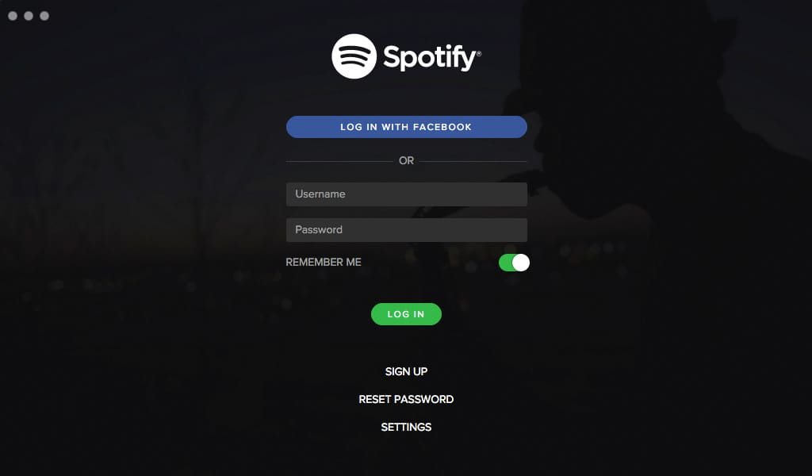
SPOTIFY LOGIN
In order to access users' Spotify data, they will need to login to their Spotify accounts. This will give our application permission to access the user's Spotify account data so it can interact with their Spotify account.

Slide 5
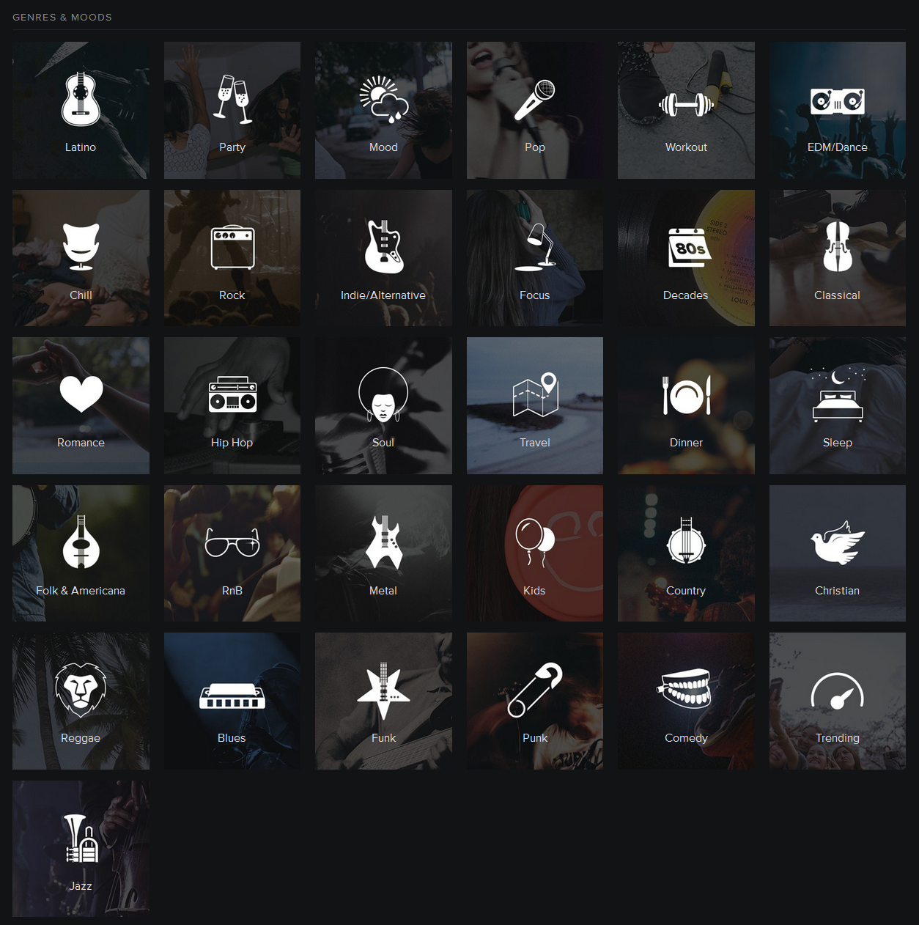
MUSIC DISCOVERY PREFERENCES
Users will be prompted to fill out a form which they will use to indicate their music discovery preferences.
This will be a survey in which users can indicate their preferences for music that they want exposure to in order for our app to follow new playlists on their behalf. Users can enter preferences for genre, tempo, danceability, etc. These options will reflect Spotify’s categorizations.
Users will interact with this like a survey. This will be an entry form with multiple choice buttons for each question. Most questions will allow for multiple answers.
Our application will be able to generate a sample consisting of playlists that reflect the preferences of our users. From this sample, our application will be able to pull a smaller selection to follow on behalf of the user that week.

Slide 6
MUSIC SOCIAL MEDIA: USER PROFILE PAGES
Users will be able to interact with one another's profile pages that essentially serve as expanded Spotify user profiles that display:
All user posts
All-time favorite artists, songs, genres
User reviews of the playlists our playlist follow feature selected for them
Favorites, most and least highly recommended, etc.

Slide 7
SOCIAL MEDIA POST FEED
A central social feed that consists of the following:
A post option where users can create posts for their followers on Spotify, and view posts created by people they follow.
Users will be able to open a textbox, in which they can fill with their thoughts, recommendations, attach playlists, artists, or songs, and share these custom-made posts with their friends and followers.
These posts created will then be posted to the central feed for the followers of the user and added to the user’s main profile page.

Slide 8
Notifications
Notification page informing users of the playlists that our app followed via their Spotify accounts based off their preferences for music discovery. (Similar to Instagram notifications page)
The page will keep a history of notifications. Users can choose to keep or delete notifications on the log.
Once the playlists have been discovered and followed for users, they will all appear in a central page that notifies the user.
The user will then be able to view each playlist and decide if they want to add them to their profiles or delete them from this result page.

Slide 9
System requirements
NON-FUNCTIONAL REQUIREMENTS:
PLAYLIST GENERATION SPEED
APPLICATION DOWNTIME
ACCOUNT SECURITY

Slide 10

Playlist generation speed
This non-functional requirement is the speed at which playlists should be generated for users once they fill out their weekly preference forms. With advanced and efficient search algorithms, this process should only take at most 10 seconds to generate all possible playlists.
This relates to our function requirement, Music Discovery Preferences, since this is the speed at which discovery will occur.
This Photo by Unknown author is licensed under CC BY-NC-ND.

Slide 11
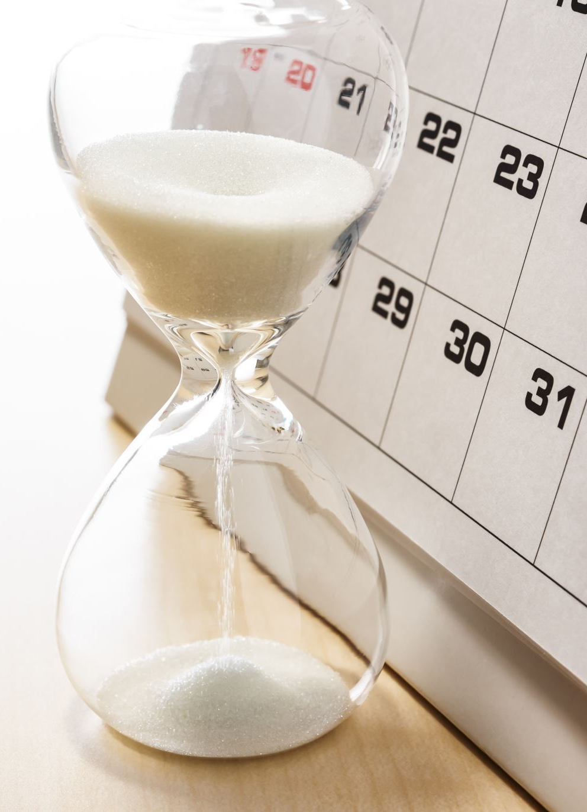
Application downtime
This is the downtime that the application will have each month for server and website related fixes, which will not exceed more than an hour per month.

Slide 12

Account security
Each user account will be individualized and therefore, they need to be encrypted for the safety of our users. There will be inactivity timeouts, so users are logged out of their accounts when they aren't using them.

Slide 13
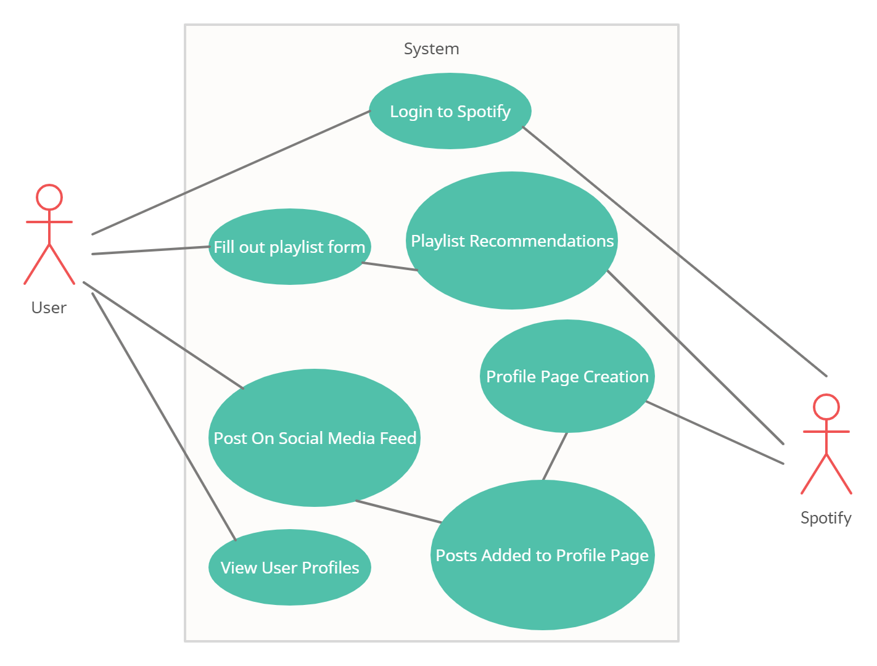
Use Case Diagram

Slide 14
SYSTEM CONSTRAINTS
TOOL CONSTRAINTS
LANGUAGE CONSTRAINTS
PLATFORM CONSTRAINTS
HARDWARE AND NETWORK CONSTRAINTS
DEVELOPMENT, TRANSITION AND SUPPORT, AND BUDGET AND SCHEDULE CONSTRAINTS

Slide 15
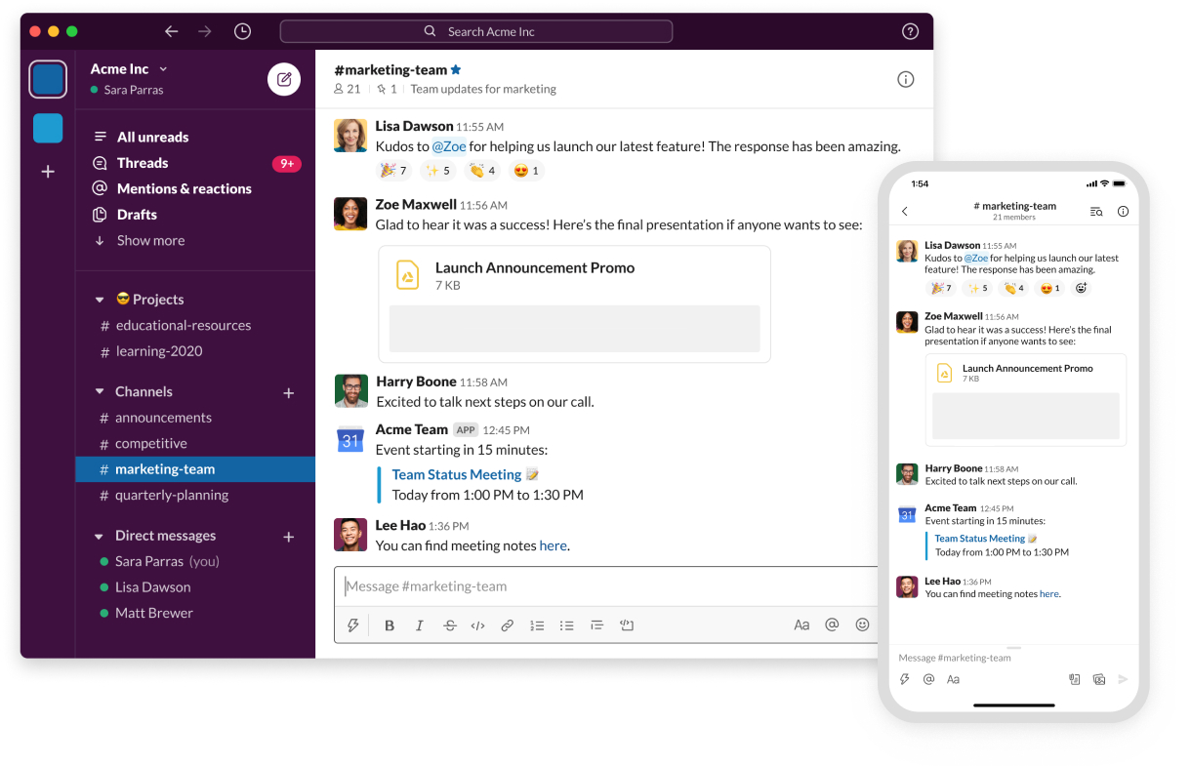
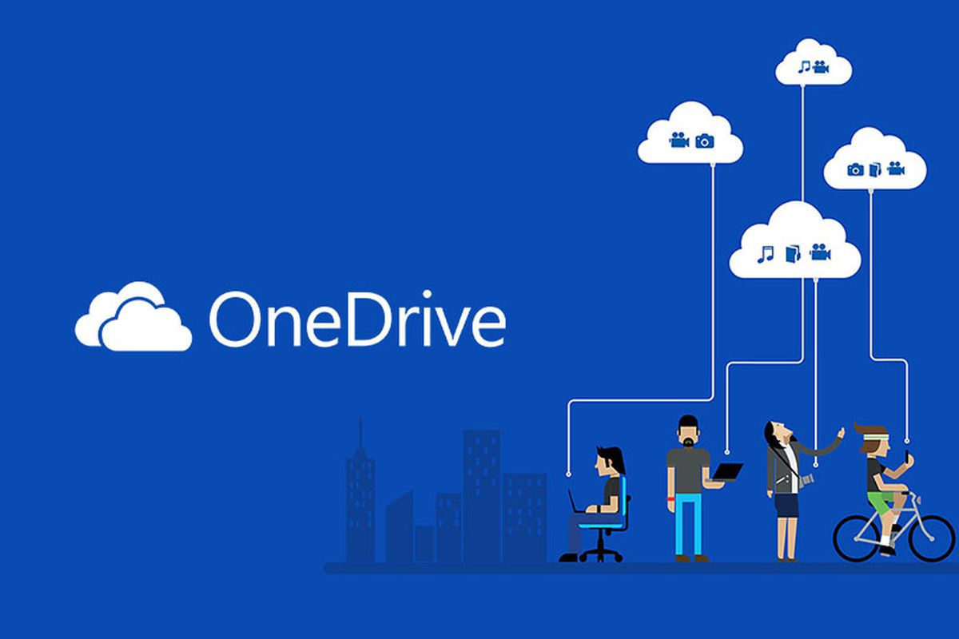
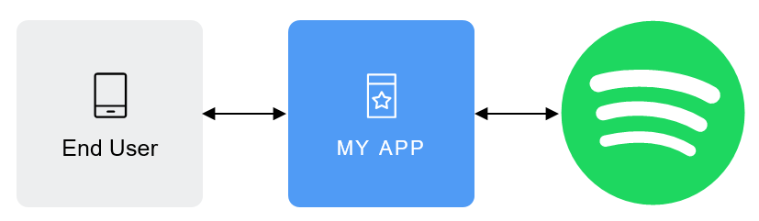
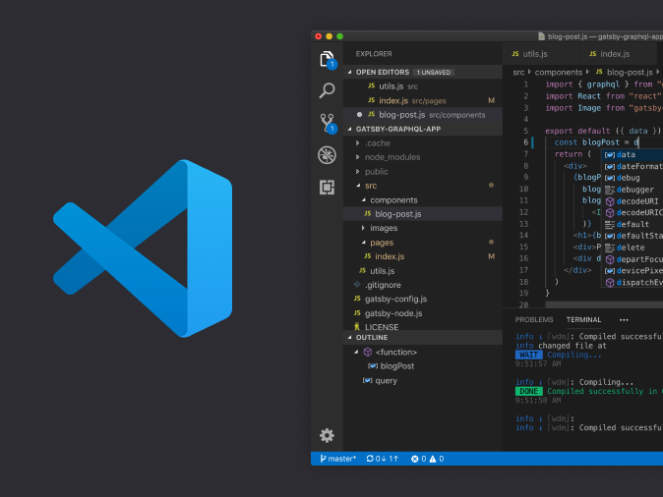
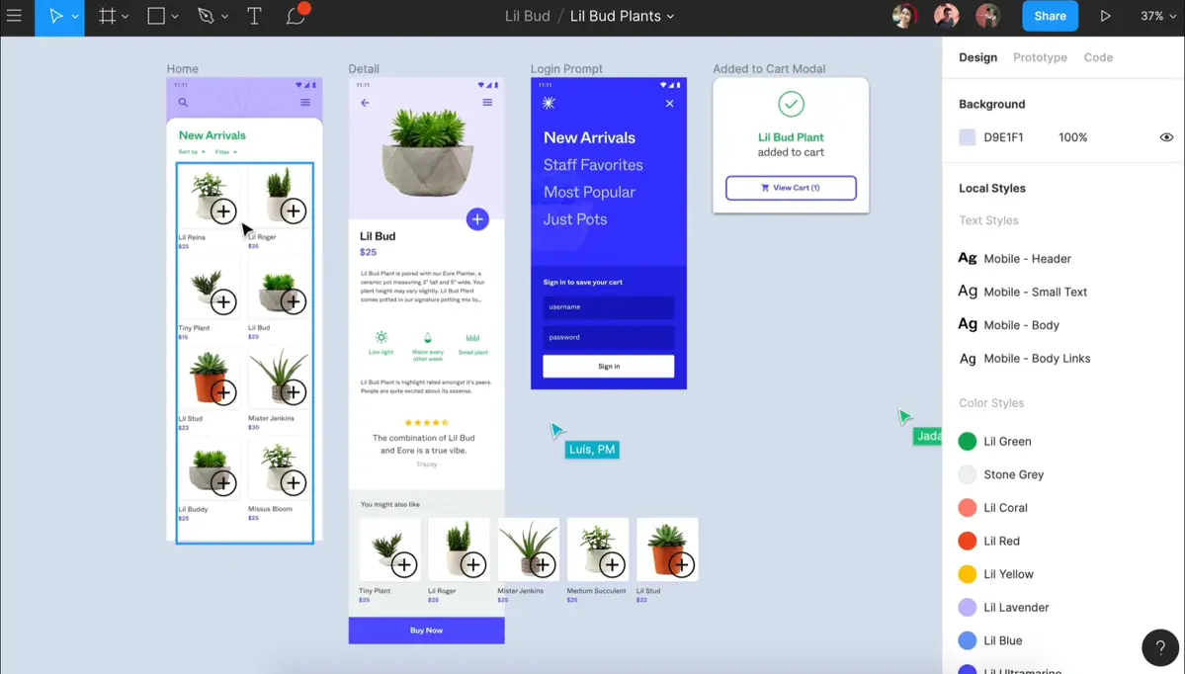
Tool Constraints
Productivity Tools
Slack for team communication between team members as well as with TAs and Professor Aguiar
Collaboration Tools
Microsoft One Drive to store, share, and collaborate on PowerPoints and Word Documents
Design Tools
Figma for building the wireframes of the application
Integrated Development Environment (IDE)
Visual Studio Code to develop our code base for this application
Spotify API
A very important tool for our application, which will allow us to use Spotify's login terminal, playlist catalogue, and user profile information.

Slide 16

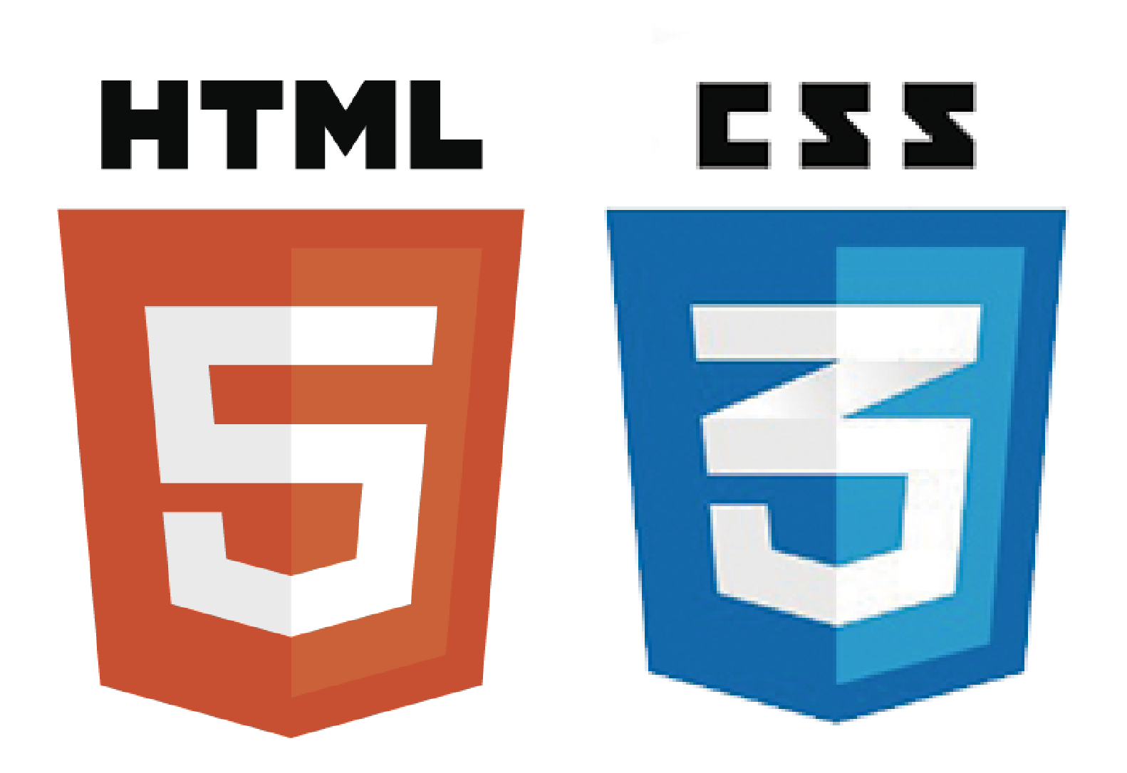

Language Constraints
HTML
CSS
JavaScript
Node.js

Slide 17


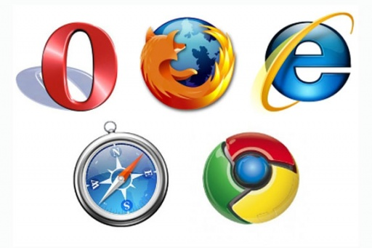
Platform Constraints
IOS
Android
Web

Slide 18
Hardware Constraints
Device accessibility
Internet Connected Device
Team productivity tools such as laptops and desktops
Basic internet connection
Network and server bandwidth for users
Network Constraints

Slide 19
Deployment Constraints
Transition and Support Constraints
Semester difficultly variability can lead to issues with deployment of the application for the team members
Final project slide show deadline: April 20th
Final project package deadline: May 1st
End of life is when the end of the semester occurs because the application will no longer be supported
Budget and schedule Constraints

Slide 20


Evolutionary Requirements
Functional Requirements
Implement version 1(IOS/Android) functional requirements on a web application
Leverage App Store/Google Play ratings to acquire userbase
Make platform accessible and test on major web browsers

Slide 21
Thank You for Listening
Any Questions?

